Slide 1

CS144 An Introduction to Computer Networks
Ethernet and CSMA/CD
Nick McKeown
Professor of Electrical Engineering
and Computer Science, Stanford University
Notes:
You will remember from an earlier video that if a network is carrying only one flow, AIMD will keep the bottleneck link full all the time, and therefore we say the throughput is equal to the data rate of the bottleneck link. Nice and simple.
Things get quite a bit more complicated if the network is carrying lots of AIMD flows, all sharing a bottleneck link. In this video, I am going to derive a throughput formula for AIMD with multiple flows sharing the network. This video contains more equations than most of the videos, so keep your wits about you and keep a close eye on the assumptions I am making as I go along.

Slide 2
The 4 Layer Internet Model
Source End-Host
Destination End-Host
Application
Application
Transport
Transport
Router
Router
Network
Network
Network
Network
Link
Link
Link
Link
Notes:
The next layer up is, for us, the most important layer: the Network layer.
The network layer’s job is to deliver packets end-to-end across the Internet from the source to the destination.
A packet is an important basic building block in networks. A packet is the name we give to a self-contained collection of data, plus a header that describes what the data is, where it is going and where it came from. You will often see packets drawn like this: <draw a packet with header and data>
Network layer packets are called datagrams. They consist of some data and a head containing the “To” and “From” addresses – just like we put the “To:” and “From” addresses on a letter. <Draw a datagram with To/From addresses> .
The Network hands the datagram to the Link Layer below <click to wipe arrows down>, telling it to send the datagram over the first link. In other words, the Link Layer is providing a *service* to the Network Layer. Essentially, the Link Layer says: “if you give me a datagram to send, I will transmit it over one link for you”.
At the other end of the link is a router. The Link Layer of the router accepts the datagram from the link, and hands it up to the Network Layer in the router. The Network Layer on the router examines the destination address of the datagram, and is responsible for routing the datagram one hop at a time towards its eventual destination. It does this by sending to the Link Layer again, to carry it over the next link. And so on until it reaches the Network Layer at the destination. <sequence of clicks shows the steps>
Notice that the Network Layer does not need to concern itself with *how* the Link Layer sends the datagram over the link. In fact, different Link Layers work in very different ways; Ethernet and WiFi are clearly very different. This separation of concerns between the Network Layer and the Link Layer allows each to focus on its job, without worrying about how the other layer works. It also means that a single Network Layer has a common way to talk to many different Link Layers by simply handing them datagrams to send. This separation of concerns is made possibly by the modularity of each layer and a common well-defined API to the layer below.

Slide 3

Hurricane Electric (he.net)
JANET (ja.net)
(transatlantic cable)
yuba.stanford.edu
Stanford University
Cambridge University (UK)

Slide 4
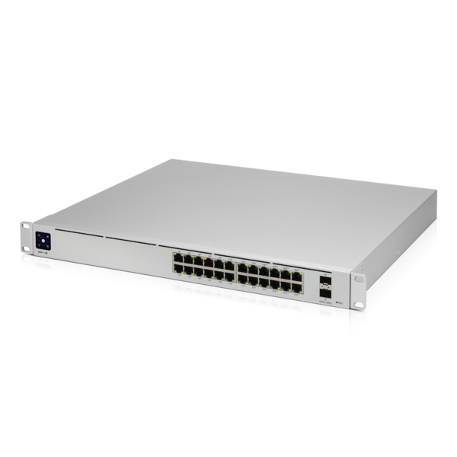
Ethernet
switches
yuba.stanford.edu
Stanford University

Slide 5
Ethernet
switch

Slide 6
Generic Packet Switch
Data
H
Lookup
Address
Update
Header
Queue
Packet
Destination
Address
Egress link
Forwarding
Table
Buffer
Memory

Slide 7
Generic Packet Switch
Data
H
Queue
Packet
Lookup
Address
Update
Header
Forwarding
Table
Buffer
Memory
Data
H
Queue
Packet
Lookup
Address
Update
Header
Forwarding
Table
Buffer
Memory
Data
H
Queue
Packet
Lookup
Address
Update
Header
Forwarding
Table
Buffer
Memory

Slide 8
Ethernet Switch
Examine the header of each arriving frame.
If the Ethernet DA (aka “MAC Address”) is in the forwarding table, forward the frame to the correct output port(s).
If the Ethernet DA is not in the table, broadcast the frame to all ports (except the one through which the frame arrived). i.e. flooding.
Entries in the table are learned by checking to see if the Ethernet SA of arriving packets are already in the table. If not, then add them.

Slide 9
Internet Router
If the Ethernet DA of the arriving frame belongs to the router, accept the frame. Else drop it.
Examine the IP version number and length of the datagram.
Decrement the TTL, update the IP header checksum.
Check to see if TTL == 0.
If the IP DA is in the forwarding table, forward to the next hop.
If IP DA doesn’t match a table entry
If there is a Default Route entry, then forward to it (often a BGP router).
Else, drop the packet and send an ICMP message back to the source.
Find the Ethernet DA for the next hop router.
Create a new Ethernet frame and send it.

Slide 10
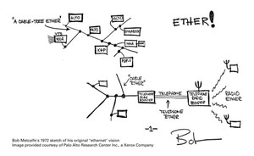
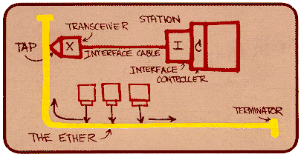
The Original Ethernet
Original pictures drawn by Bob Metcalfe, co-inventor of Ethernet (1972 – Xerox PARC)
Notes:
I have email permission from Bob Metcalfe to use these.

Slide 11
Ethernet Frame Format
1st bit on wire
Bytes:
7
1
6
6
2
0-1500
0-46
4
CRC
Pad
Data
Type
SA
DA
SFD
Preamble
Preamble: trains clock-recovery circuits
Start of Frame Delimiter: indicates start of frame
Destination Address: 48-bit globally unique Ethernet address assigned by manufacturer. 1b: unicast/multicast 1b: local/global address
Type: Indicates protocol of encapsulated data (e.g. IP = 0x0800)
Pad: Zeroes used to ensure minimum frame length
Cyclic Redundancy Check: check sequence to detect bit errors.

Slide 12

The origins of Ethernet

Slide 13
Sharing a “medium”
Ethernet is, or at least was originally, an example of multiple hosts sharing a common cable (“medium”).
To share the medium, we need to decide who gets to send, and when.
There is a general class of “Medium Access Control Protocols”, or MAC Protocols. Hence the name “MAC address”.
Ethernet uses a MAC protocol called “CSMA/CD”.

Slide 14
CSMA/CD Protocol
All hosts transmit & receive on one channel
Packets are of variable size.
When a host has a packet to transmit:
Carrier Sense: Check if the line is quiet before transmitting.
Collision Detection: Detect collision as soon as possible. If a collision is detected, stop transmitting; wait a random time, then return to step 1.
binary exponential backoff

Slide 15

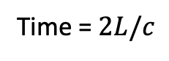
CSMA/CD Packet size requirement
A
B
C
D
L/c
Time = 0
Time = L/c - ε
Time = L/c
Time = $2L/c$
First time “A” knows about collision
Therefore, Host A is guaranteed to know about the collision while it is still transmitting if:$\frac{P}{R}>\frac{2L}{c}$

Slide 16
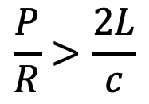
CSMA/CD Packet size requirement
A
B
C
D
R
L/c
For an end host to detect a collision before it finishes transmitting a packet, we require:
where P is the size of a packet.
$$\frac{P}{R}>\frac{2L}{c}$$

Slide 17
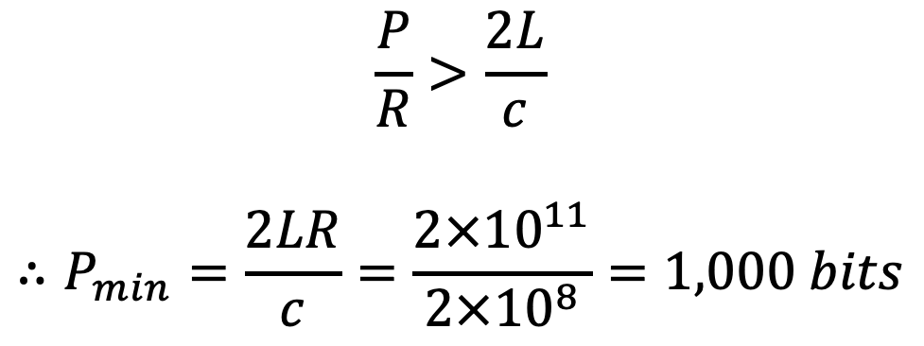
CSMA/CD Packet size requirement
Example:
R = 10Mb/s, L = 10,000m, c = 2 x 10⁸ m/s.
A
B
C
D
L/c
$$\frac{P}{R}>\frac{2L}{c}$$
$$∴P_{min}=\frac{2LR}{c}=\frac{2×{10}^{11}}{2×{10}^{8}}=1,000 bits$$

Slide 18
Ethernet evolution
Early 1980s: Ethernet was a 10Mb/s shared medium. Literally a thick coaxial cable that snaked around the floor into which every computer was plugged.
Late 1980s: Ethernet “10baseT” used the twisted-pair phone cables already installed in buildings. Used a star topology. Ethernet hubs connected end hosts together with one big collision domain.
Early 1990s: Ethernet Switches were invented. Dedicated cable between the switch and the end host carrying packets in both directions simultaneously. No collisions any more!
Since then: 100Mb/s Ethernet, 1GE, 10GE, 100GE, 400GE, …

Slide 19
Ethernet
switches
yuba.stanford.edu
Stanford University

Slide 20
Autonomous Systems (AS’s) usually connect to each other
in an Internet eXchange Point (IXP)
he.net
AS 6939
Ethernet Switch(es)
Provided by IXP
Level3
AS 3356
Stanford
AS 32
CENIC
AS 2152
Other ISPs at local IXP

Slide 21
The 4 Layer Internet Model
Source End-Host
Destination End-Host
Application
Application
Transport
Transport
Router
Router
Network
Network
Network
Network
Link
Link
Link
Link
Notes:
The next layer up is, for us, the most important layer: the Network layer.
The network layer’s job is to deliver packets end-to-end across the Internet from the source to the destination.
A packet is an important basic building block in networks. A packet is the name we give to a self-contained collection of data, plus a header that describes what the data is, where it is going and where it came from. You will often see packets drawn like this: <draw a packet with header and data>
Network layer packets are called datagrams. They consist of some data and a head containing the “To” and “From” addresses – just like we put the “To:” and “From” addresses on a letter. <Draw a datagram with To/From addresses> .
The Network hands the datagram to the Link Layer below <click to wipe arrows down>, telling it to send the datagram over the first link. In other words, the Link Layer is providing a *service* to the Network Layer. Essentially, the Link Layer says: “if you give me a datagram to send, I will transmit it over one link for you”.
At the other end of the link is a router. The Link Layer of the router accepts the datagram from the link, and hands it up to the Network Layer in the router. The Network Layer on the router examines the destination address of the datagram, and is responsible for routing the datagram one hop at a time towards its eventual destination. It does this by sending to the Link Layer again, to carry it over the next link. And so on until it reaches the Network Layer at the destination. <sequence of clicks shows the steps>
Notice that the Network Layer does not need to concern itself with *how* the Link Layer sends the datagram over the link. In fact, different Link Layers work in very different ways; Ethernet and WiFi are clearly very different. This separation of concerns between the Network Layer and the Link Layer allows each to focus on its job, without worrying about how the other layer works. It also means that a single Network Layer has a common way to talk to many different Link Layers by simply handing them datagrams to send. This separation of concerns is made possibly by the modularity of each layer and a common well-defined API to the layer below.

Slide 22
Ethernet switches operate at the link layer
Router 1
Router 2
Network
Network
IP Data
IP Hdr
Ethernet
Switch A
Ethernet
Switch B
Link
Link
Link
Link
Eth Hdr
IP Data
IP Hdr
Eth Hdr
IP Data
IP Hdr
Eth Hdr
CRC
CRC
CRC
Ethernet DA of Router 2
Notes:
The next layer up is, for us, the most important layer: the Network layer.
The network layer’s job is to deliver packets end-to-end across the Internet from the source to the destination.
A packet is an important basic building block in networks. A packet is the name we give to a self-contained collection of data, plus a header that describes what the data is, where it is going and where it came from. You will often see packets drawn like this: <draw a packet with header and data>
Network layer packets are called datagrams. They consist of some data and a head containing the “To” and “From” addresses – just like we put the “To:” and “From” addresses on a letter. <Draw a datagram with To/From addresses> .
The Network hands the datagram to the Link Layer below <click to wipe arrows down>, telling it to send the datagram over the first link. In other words, the Link Layer is providing a *service* to the Network Layer. Essentially, the Link Layer says: “if you give me a datagram to send, I will transmit it over one link for you”.
At the other end of the link is a router. The Link Layer of the router accepts the datagram from the link, and hands it up to the Network Layer in the router. The Network Layer on the router examines the destination address of the datagram, and is responsible for routing the datagram one hop at a time towards its eventual destination. It does this by sending to the Link Layer again, to carry it over the next link. And so on until it reaches the Network Layer at the destination. <sequence of clicks shows the steps>
Notice that the Network Layer does not need to concern itself with *how* the Link Layer sends the datagram over the link. In fact, different Link Layers work in very different ways; Ethernet and WiFi are clearly very different. This separation of concerns between the Network Layer and the Link Layer allows each to focus on its job, without worrying about how the other layer works. It also means that a single Network Layer has a common way to talk to many different Link Layers by simply handing them datagrams to send. This separation of concerns is made possibly by the modularity of each layer and a common well-defined API to the layer below.

Slide 23
Why an IXP uses Ethernet switches…
The IXP doesn’t need to maintain routing tables
The IXP doesn’t need to exchange routing entries with its customers
The IXP doesn’t need to decide how packets are routed
It merely provides “Link Layer” connectivity among its customers.

Slide 24
Ethernet in use today
Almost all enterprises and campuses use Ethernet as a simple, quick, cheap, easy-to-manage way to interconnect hosts and WiFi APs inside a building. Routers are typically use to connect buildings together.
Data-centers typically use an Ethernet switch to connect 48-64 servers together in each rack. Called “Top of Rack” or ToR switches. Routing is typically used to connect racks together.

